Slide 1
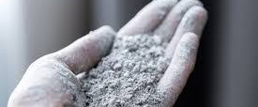
Be Silica Safe!!

Slide 2
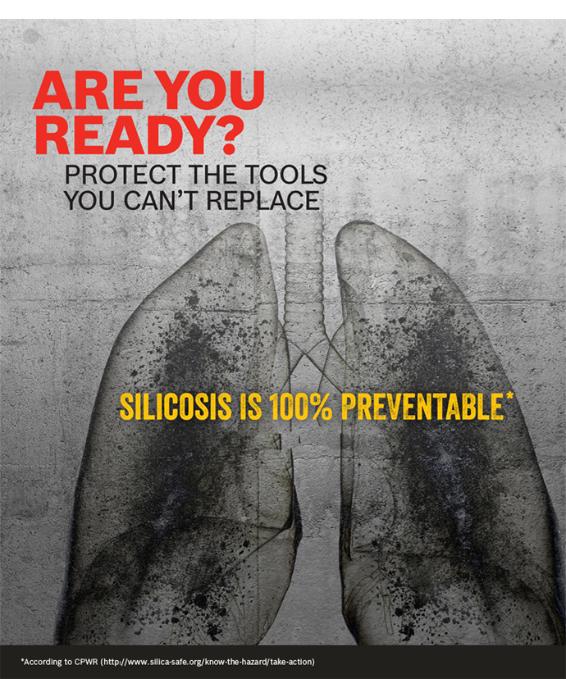
Purpose of this presentation
Due to the re-emergence of Silicosis, it is important that information is accessible for employers and employees as knowledge is the key to preventing this disease.
The purpose is to also ensure that staff and contractors understand the hazards, how to eliminate any health or environmental risk and comply with legislative requirements.
Although the Silicosis Support Network is here to help, you should always seek medical advice from a qualified GP and/or specialist regarding any questions or concerns you have about your health

Slide 3
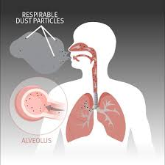
What is crystalline silica?
Silica is silicon dioxide, a naturally occurring, widely abundant mineral that forms the major component of most rocks and soils. There are non-crystalline and crystalline forms of silica. Crystalline silica is also known as free silica. Crystalline silica dust particles that are small enough to penetrate deep into the lung are termed respirable. Respirable crystalline silica may cause lung damage and disease.
There is no cure for Silicosis—prevention is the only option and for many years, it has been known that prolonged inhalation with consistent exposure (around 5-7 years) of respirable crystalline silica dust may cause a specific type of lung damage called Silicosis. In fact, Silicosis is the world’s oldest known occupational disease.
The most common form of crystalline silica is quartz. Crystalline silica is found in varying proportions in aggregates, mortar, concrete and stone. Granite contains 25 to 40% quartz, shales average 22% and sandstones average 67% quartz. Quartz is the major component of sand in locations like stream beds, beaches and deserts. Other polymorphs of silicon dioxide, including cristobalite and tridymite are less common.
An increase in the number of workers diagnosed with Silicosis and Progressive Massive Fibrosis (PMF) has been linked to working with composite stone. Composite stone products can contain up to 97 per cent silica. The high amount of silica means that there is a very high risk of workers developing breathing problems and Silicosis if they breathe in dust made from these products. Dust containing respirable crystalline silica (RCS) is generated by high-energy processes such as cutting, sawing, grinding, drilling, polishing, scabbling and crushing of silica-containing materials.
Typical leading industries include: • tunneling • foundries • stonemasonry • cement manufacturing • power generation • brick and tile manufacturing • ceramics • construction, including granite grinding and polishing • metal polishing • architectural abrasive blasting • quarrying.

Slide 5
Daniel’s Story
Daniel’s passion is to help people affected by Silicosis to have access to the support and services they deserve
Daniel’s goal for Silicosis sufferers remains the same:
“The best advice I can give the ‘boys’ is don’t give up, I know it’s hard but it’s worth the fight”
Daniel is 32 years old and after 15 years doing a job that he loved, he was diagnosed with complicated Silicosis and will never work as a stonemason again
“Being a stonemason, that was my life, being with the boys, working hard but having a laugh too, that was my world, my identity”
He is a loving father of two daughters “I try and stay active but it’s a struggle. I can barely kick the ball with the kids for 10 minutes without stopping to catch my breath, the kids don’t get it. I hate that they see me like that, but that’s the legacy of Silicosis”.
In June 2020, Daniel completed his compensation case with Workcover, QLD and was assessed as having a ‘terminal condition’ due to Silicosis and therefore awarded the ‘special lump sum benefit’ (a ‘terminal condition’ is a legal term defined, as a condition that is expected to terminate the worker’s life).
Despite the difficulty and challenges of deteriorating health and a forced career change, Daniel has decided to enrol in a dual Diploma of Business/Management and Leadership. Despite a different work environment Daniel knows, that having a new purpose which includes focusing on the people and relationships in his life, then everything else will follow.
According to Daniel, he is feeling relieved that he can finally move forward with his life which will include consistent health monitoring and management.

Slide 6
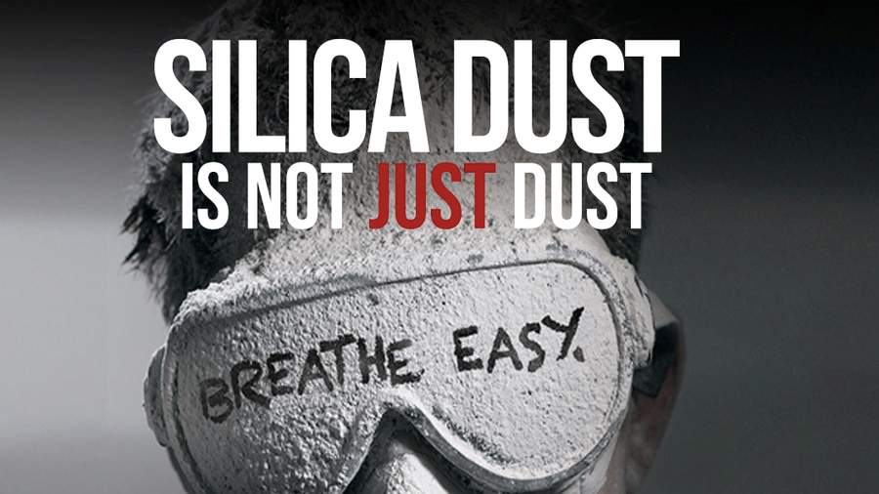
Examples of material containing Silica:
Type Amount
Granite 25 to 40%
Shale 22%
Natural sandstone 67%
Composite (engineered or manufactured) stone > 90%
Aggregates, mortar and concrete various

Slide 7
Work activities that may represent a high-risk exposure
Currently the fabrication, installation, maintenance and removal of composite stone countertops industry has the highest number of Silicosis suffers
Other Examples of work activities involving crystalline silica that require special attention when assessing exposure include but not limited to:
excavation, earth moving and drilling plant operations
clay and stone processing machine operations
paving and surfacing
mining, quarrying and mineral ore treating processes
road construction and tunneling
construction laboring and demolition
brick, concrete or stone cutting; especially using dry methods
abrasive blasting (blasting agent must not contain greater than one per cent of crystalline silica)
foundry casting
angle grinding, jack hammering and chiseling of concrete or masonry
hydraulic fracturing of gas and oil wells
pottery and other ceramics industries
crushing, loading, hauling and dumping of rock or muck, and
clean-up activities such as sweeping or pressurised air blowing of dust.
Tip: If you are unsure of what is contained in a product that you are working with, talk to your supervisor and refer to the product/manufacturer manual or MSDS

Slide 8
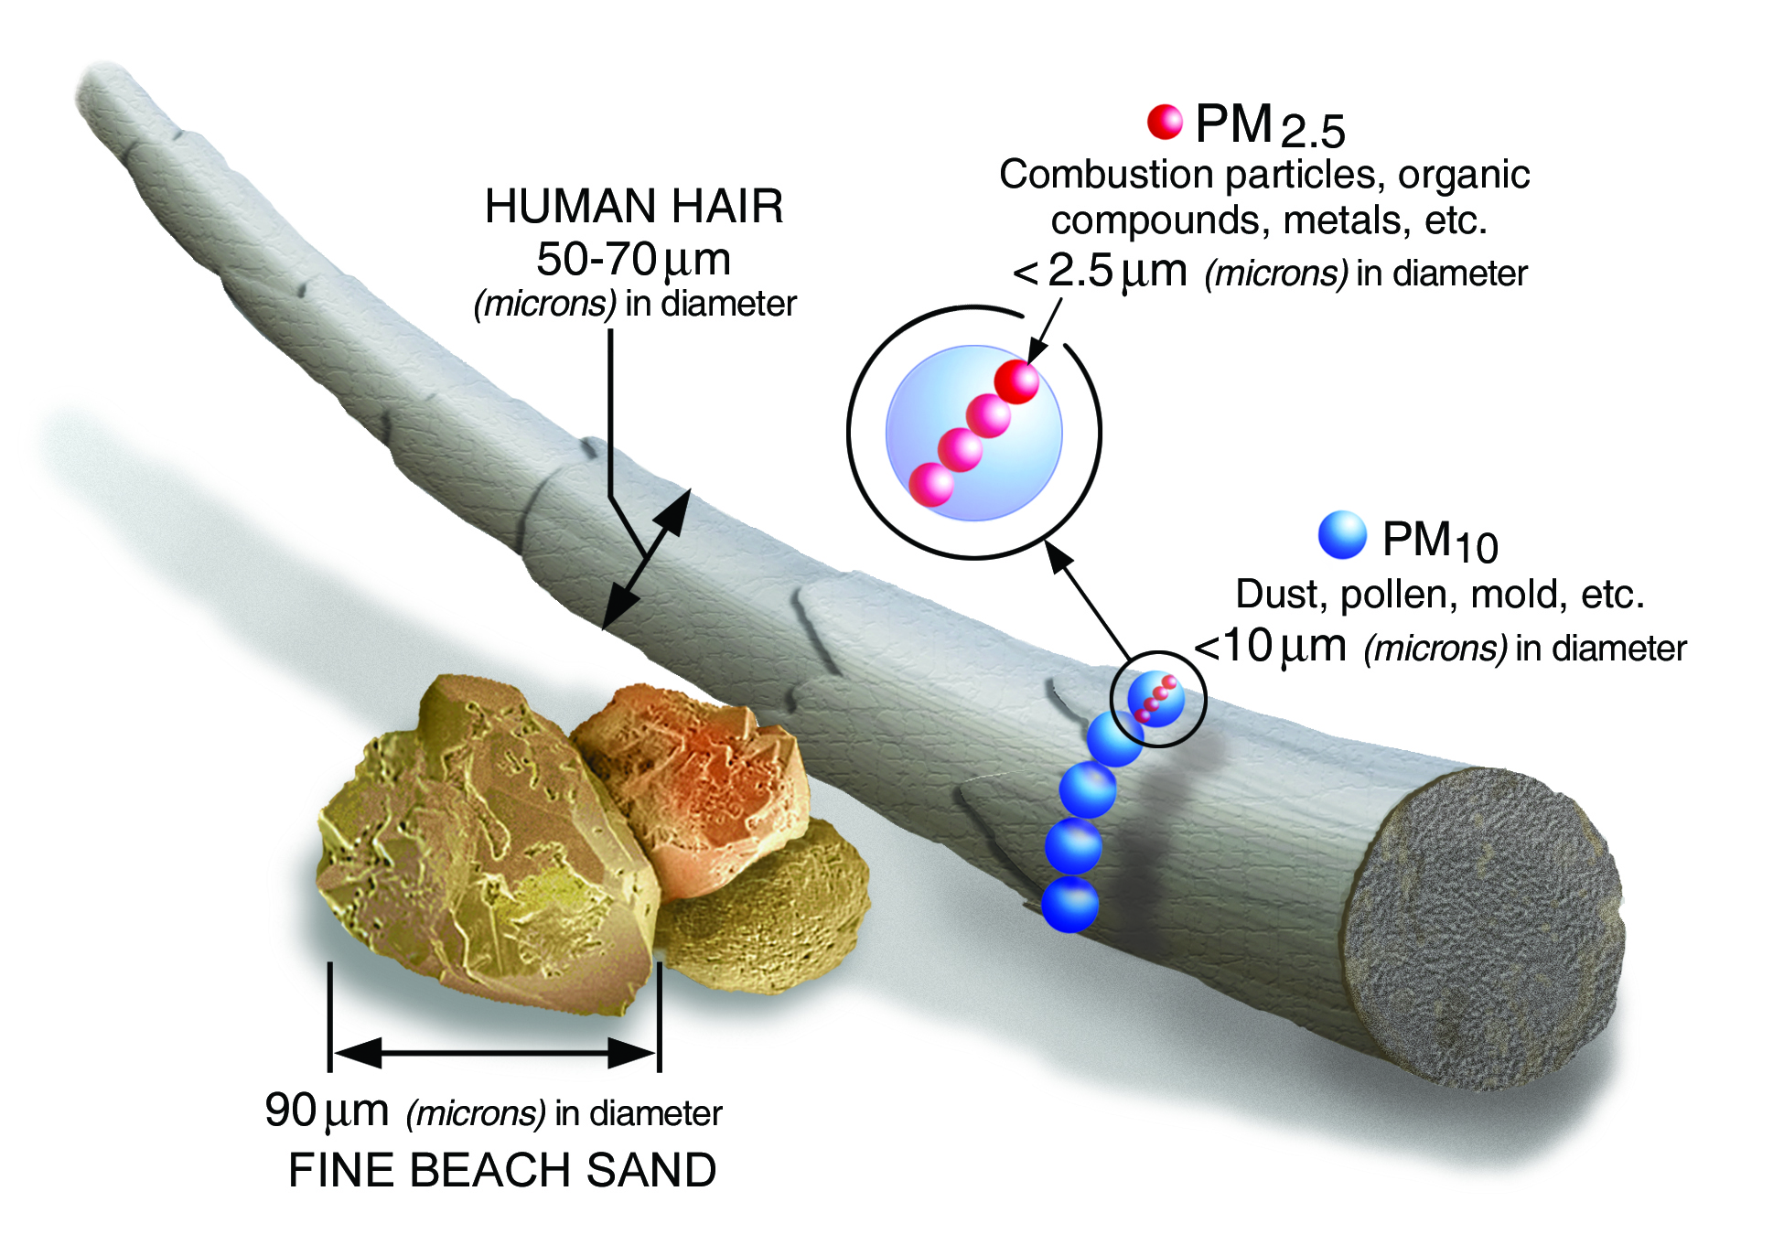
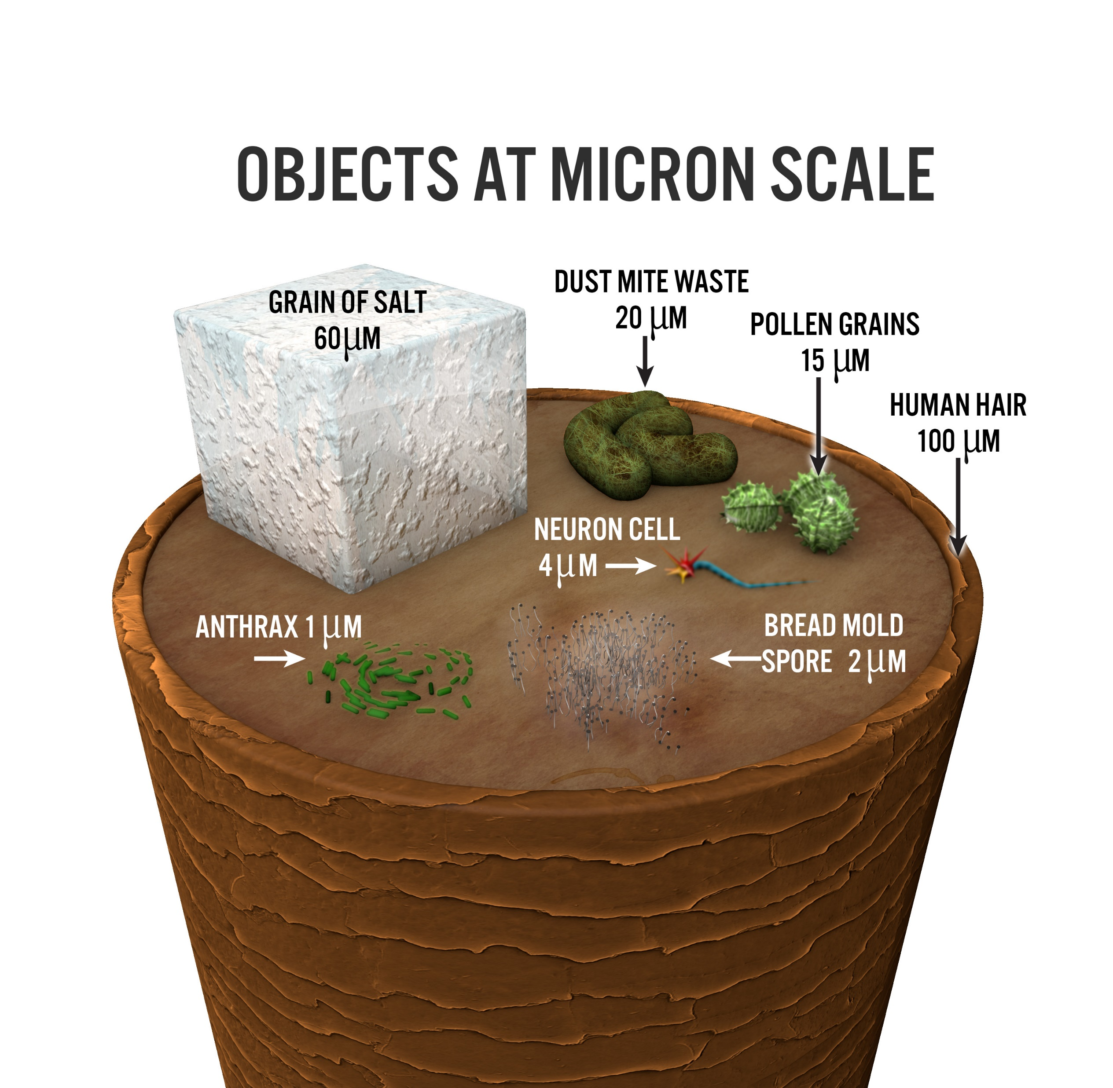
How much exposure does it take? (NB: Unlike the risk of one asbestos exposure - it takes consistent exposure to silica dust to develop Silicosis).
Development of dust related lung disease depends on several factors, such as the amount, how often and for how long a worker is exposed to silica containing dust. Some people are more susceptible than others to developing disease even though they may have had similar patterns of workplace exposure.
The workplace exposure standard for respirable crystalline silica that must not be exceeded is 0.05 mg/m3 (eight-hour time weighted average).
Worker exposures to respirable silica dust should be as low as reasonably practicable. Air monitoring will need to be conducted If there is any doubt that the exposure standard is being exceeded. To find out if there is a risk to a worker’s health, talk to your supervisor.

Slide 9
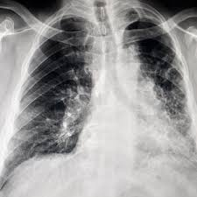
I have had occupational exposure to silica. Should I be screened for Silicosis?
Silicosis may be asymptomatic in some cases; It is possible to have Silicosis and be unaware. Silicosis can also be misdiagnosed. Symptoms may include but are not limited to:
Shortness of breath
A cough
Occasional chest pain
As the disease progresses, the shortness of breath may become worse and could lead to lasting effects. In time, the cough can become more severe and persistent, the chest pain can worsen, weight loss can occur, and night sweats can be experienced. In severe cases, respiratory failure may even cause death. People with Silicosis may have a higher risk of contracting Tuberculosis, and/or developing cancer and other related lung disease.
Loss of appetite
Tiredness/fatigue
Tip: if you’re experiencing symptoms or are concerned, it is important to mention your work history and the type of products you’ve been in contact with when talking to your GP

Slide 10
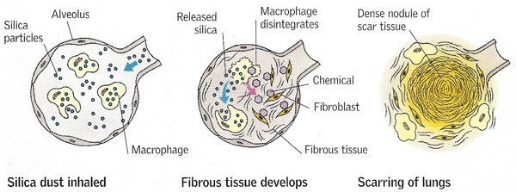
Diseases associated with silica dust
If a worker is continually exposed to and inhales silica dust they may be at risk of developing:
Simple Silicosis
In the early stages of the disease small scars called nodules begin to form
A chest X-ray identifies these irregular nodules to determine the advanced state of the disease
There may be no symptoms, or you may experience:
Shortness of breath, chest pain and/or a cough
Complicated Silicosis
When the lung nodules reach 1cm the condition is upgraded to complicated Silicosis
Progression of the disease causes large fibrotic masses in the lungs which can destroy the lungs
Progression to complicated Silicosis may occur if workers remain in or have been exposed to high concentrations of respirable dust over a longer period.
Large masses of dense scar tissue cause significantly decreased lung function, this can be fatal
Shortness of breath, chest pain, chronic cough, increased sputum/phlegm, lung dysfunction, pulmonary hypertension and/or heart complications
Some of the disease’s associated with Silicosis
Chronic bronchitis
Emphysema
Lung cancer
Kidney damage
Scleroderma
* a disease of the connective tissue of the body resulting in the formation of scar tissue in the skin, joints and other organs of the body.
Autoimmune disease’s such as Rheumatoid Arthritis and Sarcoidosis may also have links to Silicosis
Tip: All silica-related disease can be prevented by using effective controls to stop or reduce the amount of silica dust or exposure in the workplace.

Slide 11
Hierarchy of Control
Remove silica (silica is a widely abundant mineral that forms the major component of most rocks and soils)
Elimination
Substitution
Replace or reduce the product containing Silica
Engineering Controls
Isolate people from the hazard by control measures such as containment, Confinement, Ventilation/Filtration etc.
Administration Controls
Change the way people work. Introduce safe work practice, procedures, training, awareness and information/Toolbox talks etc.
PPE
Protect the worker with personal protective equipment (PPE)
“Protect your self now so you can breath easy later”

Slide 12
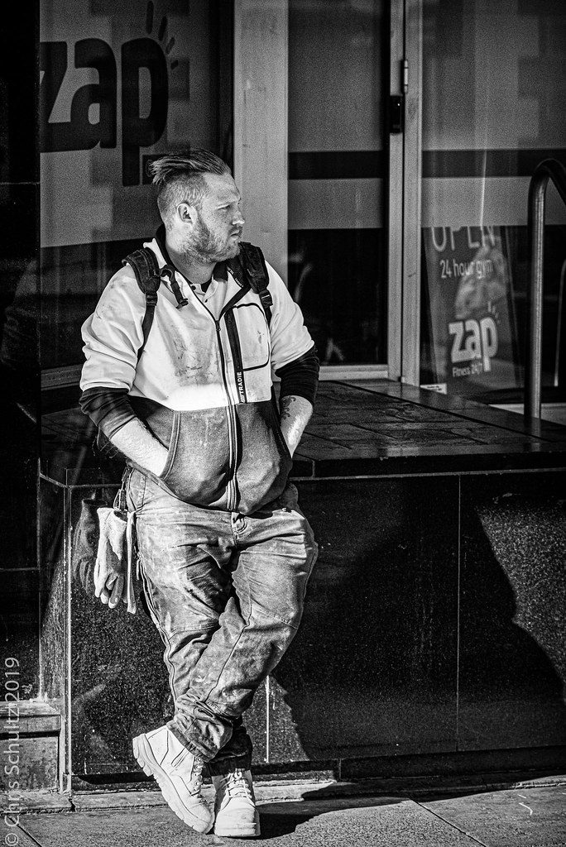
Use the SAS acronym when speaking with your GP:
Symptoms - (note what’s happening and how often)
Autobiography - (offer a detailed work history as well as recent and past symptoms)
Stamina – (Keep going back to your GP if your symptoms persist, you know yourself best).

Slide 13
Respiratory protective equipment (RPE)
Unless a workplace has undertaken air monitoring to demonstrate there is no residual risk from RCS, an RPE program that complies with Australian Standard AS 1715 must be implemented. The program must include:
provision of suitable, comfortable RPE
fit testing
facial hair policy
a maintenance and repair regime
provision of information, training and guidance to workers.
RPE must be reasonably comfortable for the wearer. Consider providing powered air purifying respirators because of the physical demands of the task and potential for a hot and humid work environment.
For more information on exposure guidelines please visit the Worksafe Australia website https://www.safeworkaustralia.gov.au/silica

Slide 14
Any Questions?
Start the Silicosis conversation
“Being a stonemason, that was my life, being with the boys, working hard but having a laugh too, that was my world, my identity”
“There are no strangers here, only friends you haven’t yet met” W.B Yeats
“I am more than this illness, you know, I don’t want sympathy, I want things to change for the other guys, I want to be part of that change, I want this to matter”
Adam Emery, (Silicosis sufferer)
“The decisions that you make today- your future self will thank you”
Talk to a mate about Silicosis….. That conversation could save a life!

Slide 15
The Silicosis Support Network understands that there are often more questions than answers when you receive a diagnosis like Silicosis. ASK we are here to help !
Reach out and remember: Protect yourself now so that you can breathe easily later…..
Website: www.silicosissupport.org.au
Phone: 1800 76 412
email us at: inquiries@ssn.org.au
Although the Silicosis Support Network is here to help, you should always seek medical advice from a qualified GP and/or specialist regarding any questions or concerns you have about your health

